Slide 1

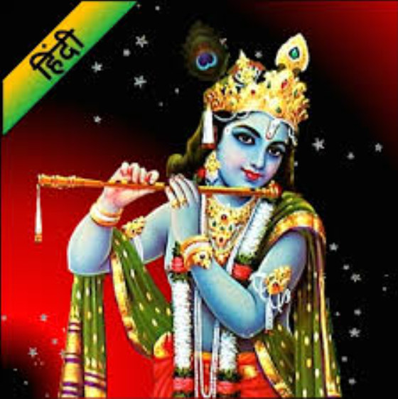


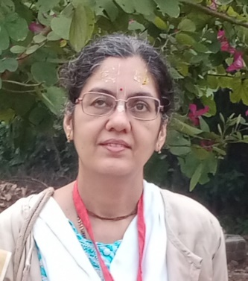
Unity Online Yoga
Holi Special
Talk on “Bhagwat Gita My Life Manual”
By
Bhajan: Mrs. Mathura Deshmukh
Deep breathing & Suryanamasar Mrs. Anjali Ghorpade
Anchoring: Mrs. Smita Joshi
Date : 4th March 2023
(Saturday Morning)
Time : 6:10am
On Google Meet
bvs-xktc-fhm
DR Priya Patil
(MD, Medicine)
Professor _ J J Hospital Mumbai

